Slide 1

Evaluation of a numerical air quality model Data wrangling large NetCDF files with R
Kristen Foley
Office of Research and Development
Computational Exposure Division
August 12, 2019
www.epa.gov/cmaq

Slide 2
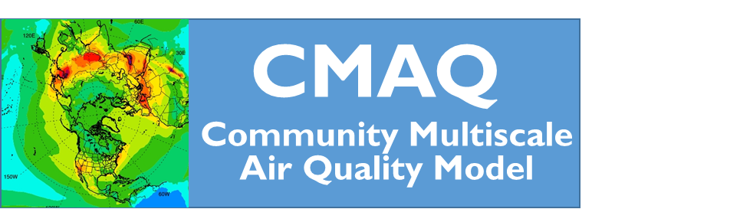
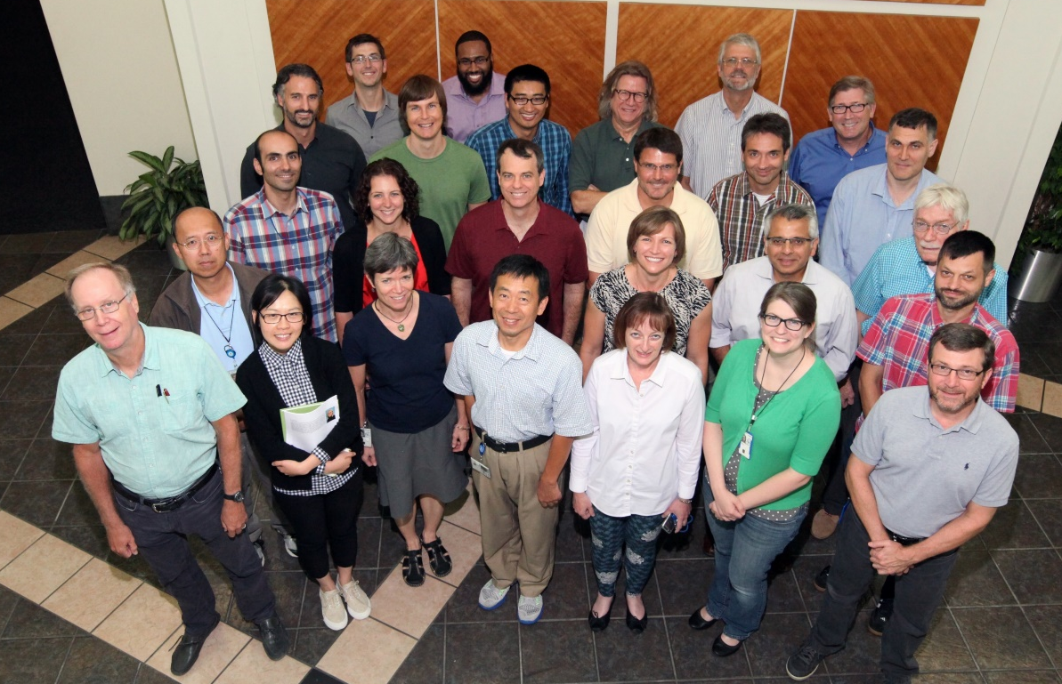
The CMAQ Team:
Office of Research and Development, NERL/Computational Exposure Division CEMM/Atmospheric & Environmental Systems Modeling Division
Mix of atmospheric scientists, chemical and environmental engineers, meteorologists, computer scientists, one statistician

Slide 3













https://www.vortech.nl/en/fortran-is-alive/
Notes:
We are a software development group and CMAQ is written in Fortran. For some of you, you many be thinking, do they even teach Fortran any more? Others of you won’t be surprised because you know Fortran is still heavily used in scientific computing. The linear algebra package, LAPACK is written in Fortran and still widely used.
For visualizing and analyzing model output, folks have a wide variety of software-of-choice. But R is a big part of our workflow.

Slide 4
Using R to evaluate a numerical air quality model
Presentation outline
What is CMAQ?
What is a NetCDF formatted file?
How do I visualize and evaluate 10s-100s of GB of model output?

Slide 5
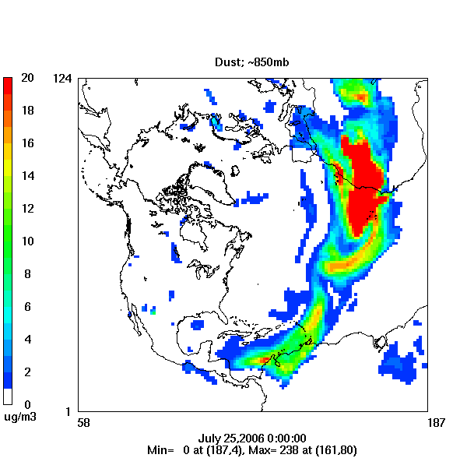
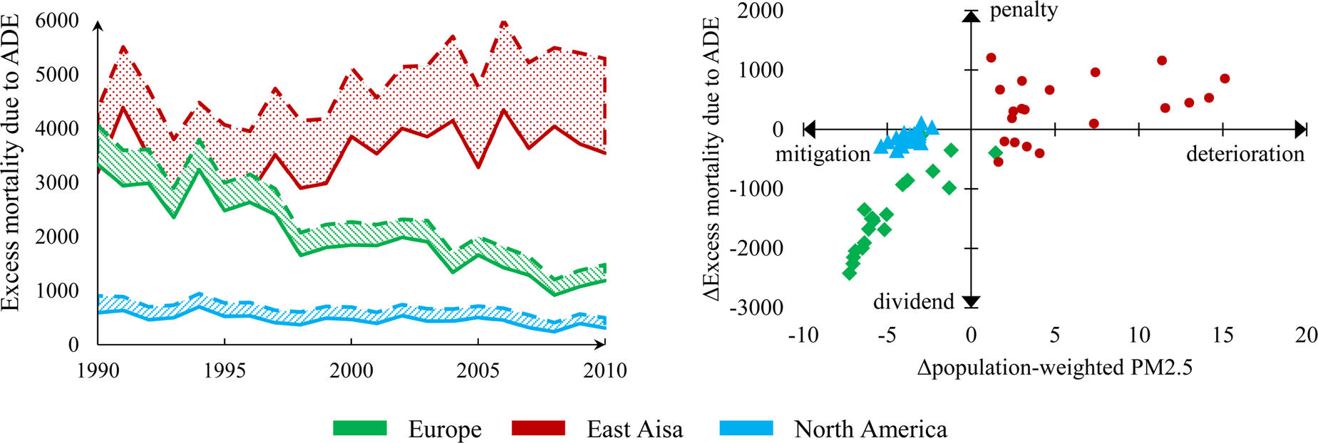
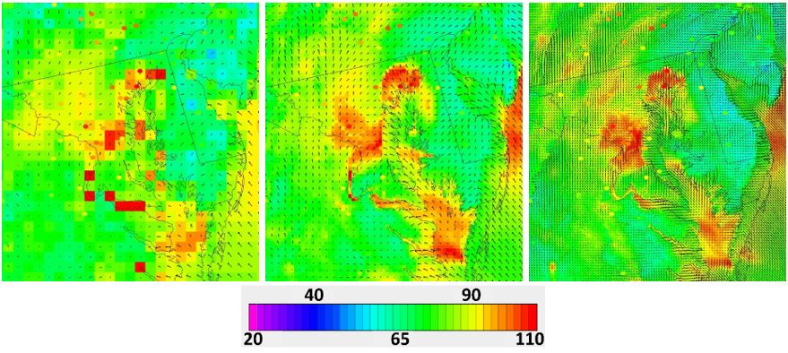
CMAQ: Exploring Air Pollution from Global Scales to Local Impacts
Health impacts from Trends in Aerosol Cooling
Windblown dust generated in the Sahara Desert and transported to the Southeast US
Xing et al. (2016) doi: 10.1021/acs.est.6b00767
Ozone and 10-m wind vectors over Maryland at 12-km, 4-km, 1-km horizontal grid spacing
Appel et al. (2014)

Slide 6
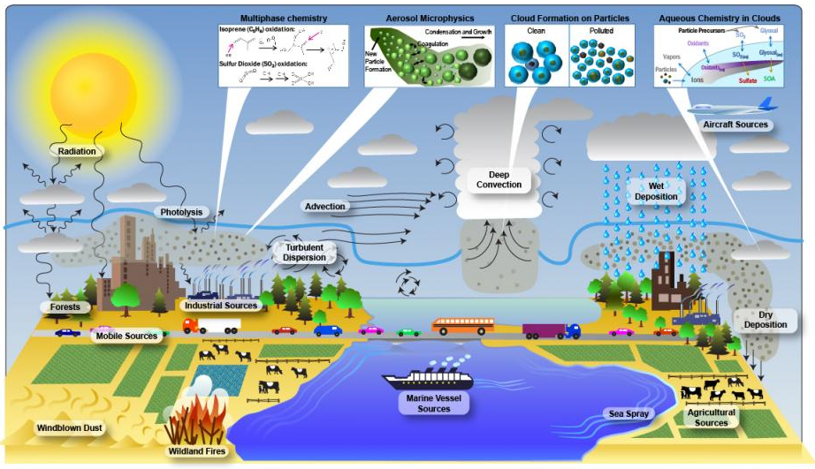
Air Quality Modeling: Complex Representation of Complex Atmospheric Processes
The model uses numerical methods to solve ordinary and partial differential equations representing chemical transformation, diffusion, advection and removal processes over time
Main Program: Fortran, > 1 million lines of code
1 year simulation over the continental US takes ~ 1 week w/ 256 cores

Slide 7
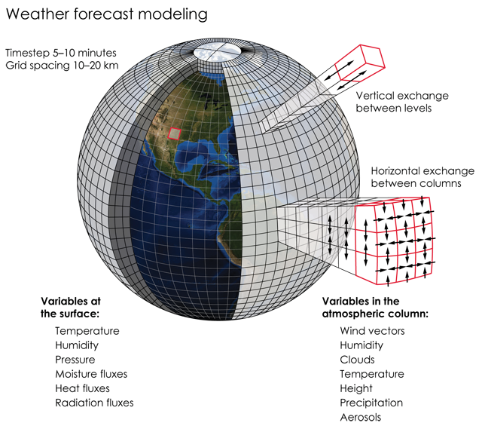
Air Quality Modeling: BIG data
Source: https://www.earthmagazine.org
Requires 100s of GBs of input data, creates TB of output data
Model output = 4D arrays of hourly output for ~ 200 chemical species
e.g. 4D array = 460 x 300 horizontal grid (grid spacing = 12km) x 35 vertical layers x 24 hrs
Output files: NetCDF formatted files with CMAQ-specific data structures
Model simulations, post processing, and evaluation are done on the High-End Scientific Computing (HESC) Linux system at the National Computer Center (NCC)

Slide 8


Network Common Data Form
Software libraries and data formats developed by Unidata
Originally designed for sharing weather data
Used for array-oriented scientific binary data
Why binary?
Save space
Save computational effort

Slide 9
Network Common Data Form
Software libraries and data formats developed by Unidata
Originally designed for sharing weather data
Used for array-oriented scientific binary data
 | .csv | .nc
Size | 14 GB | 2.8 GB
Time to write | 13 min | 0.5 min
Why binary?
Save space
Save computational effort

Slide 10
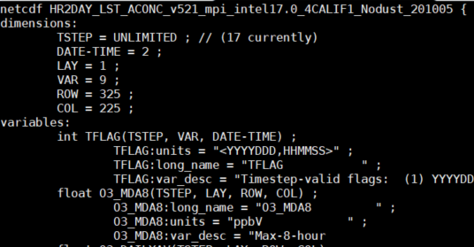
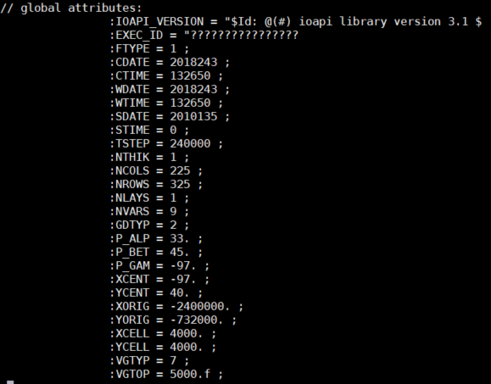
netCDF formats
“Self-describing”
File header includes dimensions of data arrays, metadata about each variable, global metadata
Beginning of header from a CMAQ output file with one variable

Slide 11
When might you encounter netCDF data?
Commonly used for earth science observations and modeling data:
Radar data
Satellite data
Numerical weather forecast data
Global climate modeling data
Ocean modeling data
CMAQ data!!
Input/output format for many GIS applications
Different datasets will have application-specific data structures and attributes

Slide 12
R Interface to netCDF format data files
ncdf4 library: 17 functions for reading, modifying, writing netCDF data files
Other packages :
RNetCDF – reading and modifying existing netCDF files
raster – reading, writing netCDF files, mapping, etc.
ncdf4.helpers – tools developed for climate model output
M3 – developed by former CMAQ team member, Jenise Swall; specifically designed to handle CMAQ outputs
Good introduction to ncdf4 functions:
http://geog.uoregon.edu/bartlein/courses/geog490/week04-netCDF.html

Slide 13
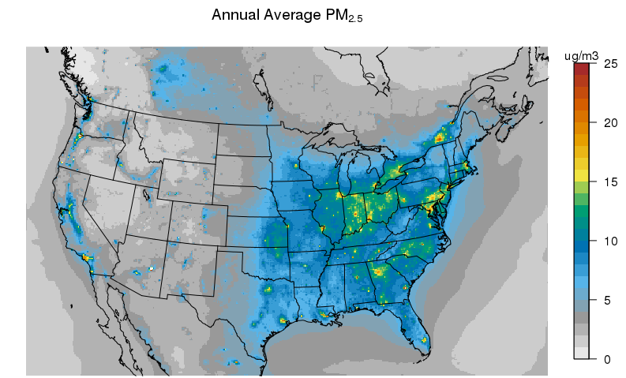
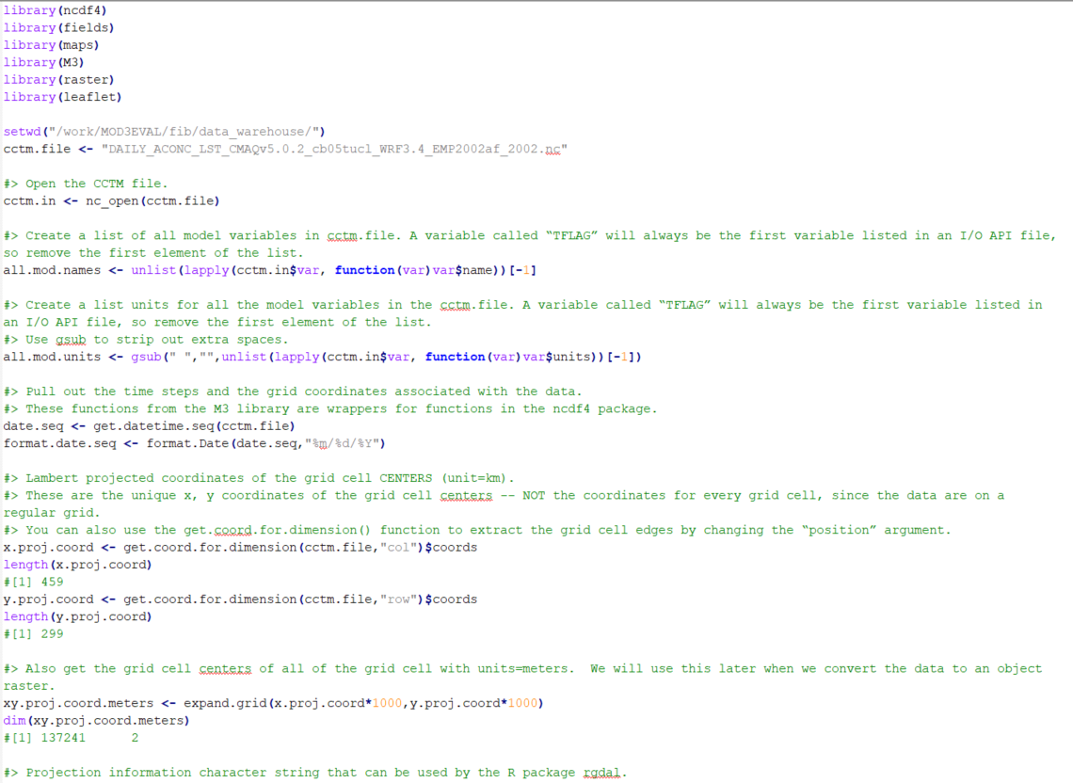
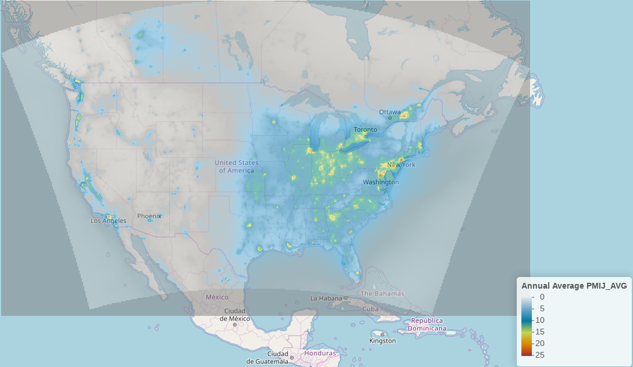
Sample R code for reading/mapping CMAQ data
2002 -2014 Daily average CMAQ output for 13 species (including SO₂, NO₂, O₃, EC, OC, PM_{2.5}, SO₄²⁻, NO₃⁻, NH₄⁺) for 2002 -2014 available online:
https://dataverse.unc.edu/dataverse/cmascenter
Sample R code available
Open .nc file
Read in 3D array of daily average PM_{2.5}
Create annual average PM_{2.5}
Map with image.plot in Lambert projected coordinates
Project to lon/lat raster object and map with Leaflet

Slide 14
Using R to evaluate the Community Multiscale Air Quality Model (CMAQ)
New versions of CMAQ are released every 1.5-3 years
Evaluation is an important part of preparing for a new release
Need evaluation tools that will:
Compare model results across different model configurations or versions
Quickly QA model output against a standard set of observational data
Evaluate model performance across pollutants, spatial and temporal scales, parts of the distribution

Slide 15
Using R to evaluate CMAQ
Aggregate and Transform
Input: CMAQ output
Output: netcdf
Software: Fortran program
Match to Obs
Evaluate
Input: .csv files
Output: MySQL database, graphics files
Software: R based package AMET
Software: Fortran program
Input: CMAQ post-processed output + observation data (text files)
Output: .csv
Visualize/QA
Input: CMAQ post-processed output
Output: graphics files, html
Software: R, VERDI, Ncview
4 TB Model data
90 GB Model data
.5 GB Obs data
1 GB Paired Model/Obs data
Post processing 1 month of model output for the continental US

Slide 16
Using R to evaluate CMAQ
Aggregate and Transform
Input: CMAQ output
Output: netcdf
Software: Fortran program
Match to Obs
Evaluate
Input: .csv files
Output: MySQL database, graphics files
Software: R based package AMET
Software: Fortran program
Input: CMAQ post-processed output + observation data (text files)
Output: .csv
Visualize/QA
Input: CMAQ post-processed output
Output: graphics files, html
Software: R, VERDI, Ncview
Automate all steps with a combination of Linux shell scripts and R code

Slide 17
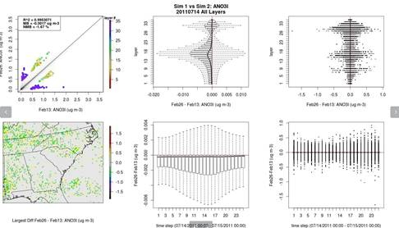
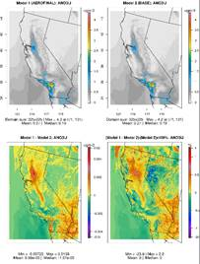
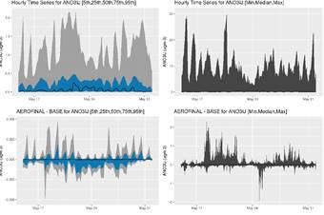
QA Code Changes with Batch R Plots
Model-to-model comparisons (no observations)
Loop over all species, look for largest differences by hour, vertical layer, spatial location

Slide 18
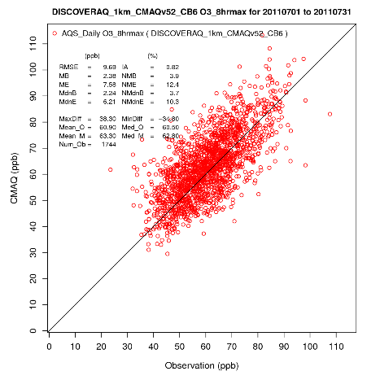
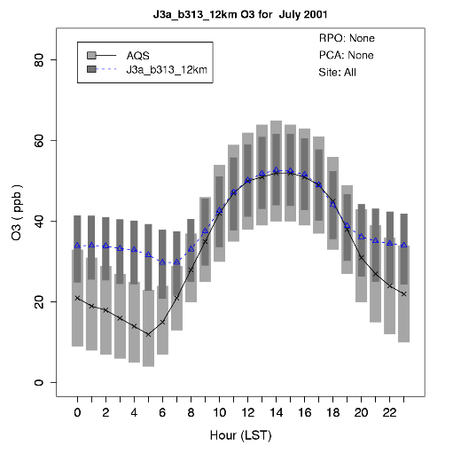
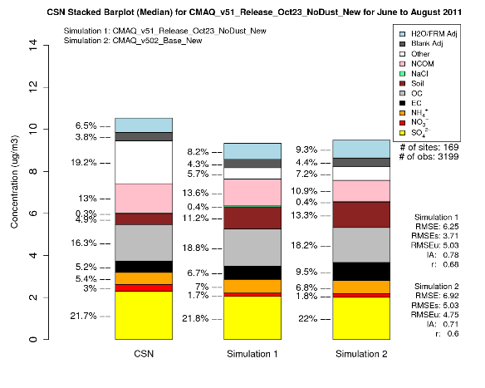
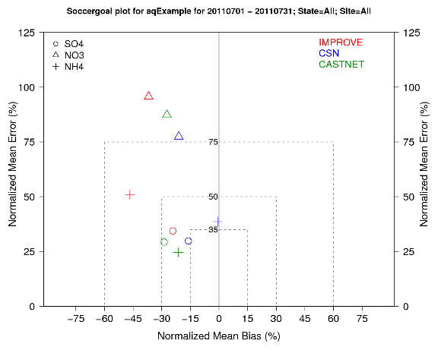
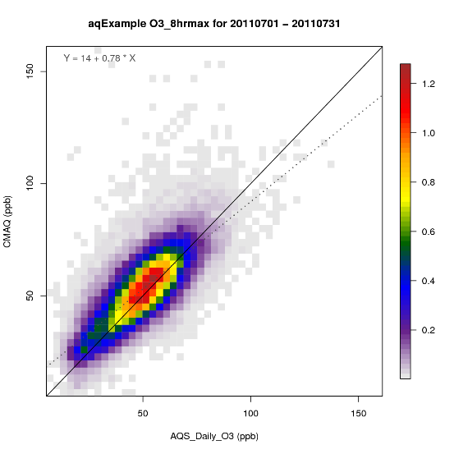
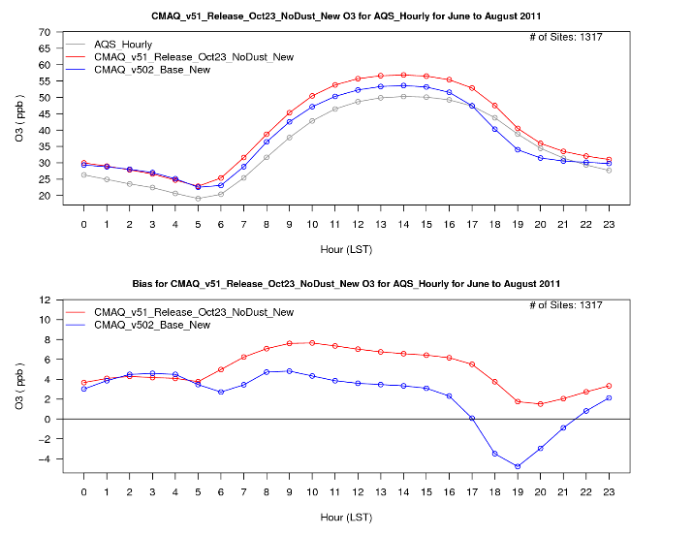
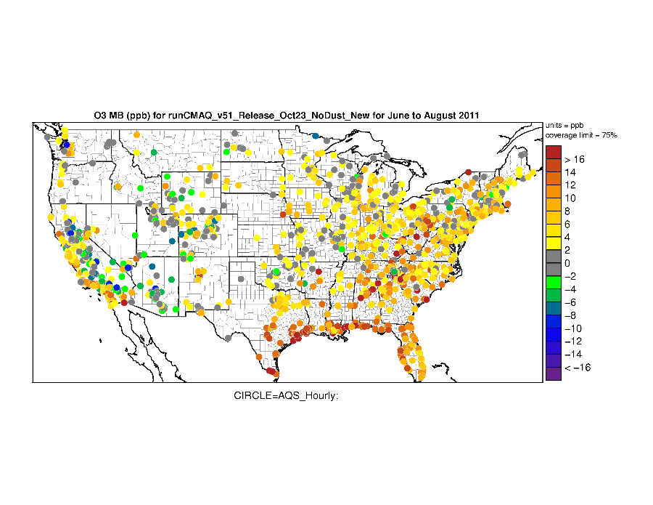
Atmospheric Model Evaluation Tool
All R plots!
Open source software publicly available on GitHub and developed by Wyat Appel (air quality eval.), Rob Gilliam (meteorological eval.)
Evaluation of air quality model output against routine networks, e.g. AQS, IMPROVE, CSN, CASTNET, NADP, SEARCH, AMON, FLUXNET

Slide 19
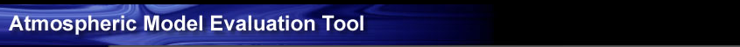
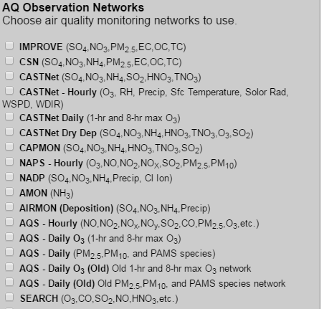
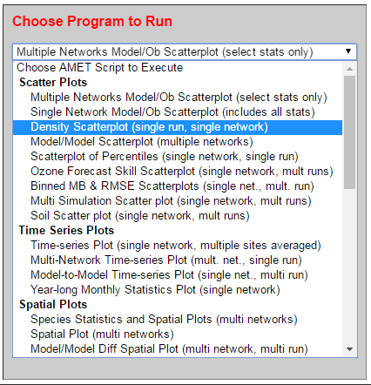
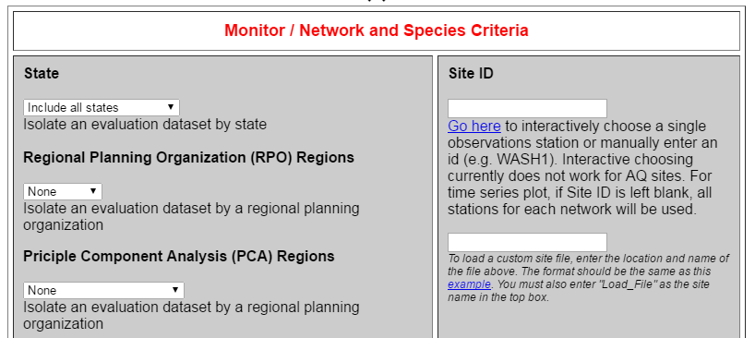
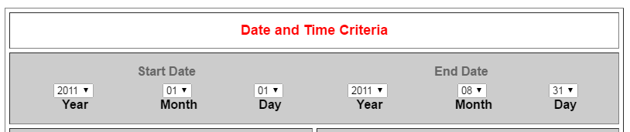
Atmospheric Model Evaluation Tool
Select model simulation, air quality monitor network data, plotting options through drop-down menus and selection boxes
Underlying MySQL database allows for easy subsetting by location/time
Clicking “Run Program” will run a single R plotting script
Web based interface available on EPA intranet
Developed over a decade ago in PHP for internal use.

Slide 20
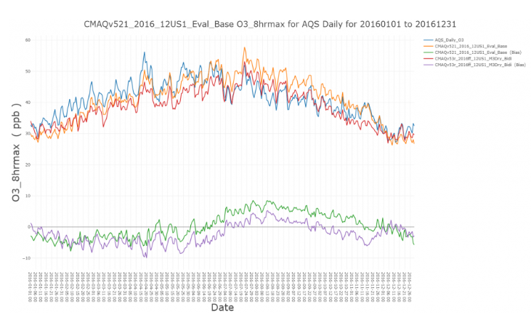
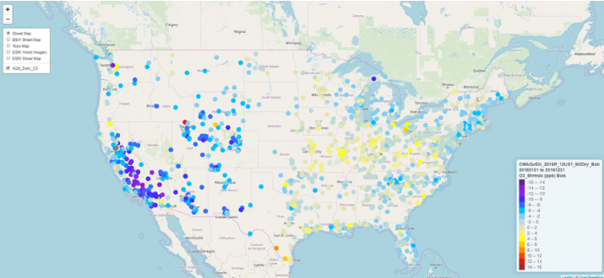
New Release: AMETv1.4
Leveraging R’s interactive plots for model evaluation
leaflet: maps
dygraph: time series
plotly: time series, bar charts, boxplots and scatter plots
Next steps
New user interface for evaluation plots – R Shiny?
Other ideas from this week’s workshop!

Slide 21
Contact and More Information
Contact
Kristen Foley: Foley.Kristen@epa.gov
Wyat Appel: Appel.Wyat@epa.gov
More Information
CMAQ site: https://www.epa.gov/cmaq
CMAQ GitHub Repository: https://github.com/USEPA/CMAQ
AMET GitHub Repository: https://github.com/USEPA/AMET

